Slide 1
Lab 11

Slide 2
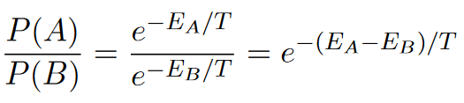
Metropolis-hastings algorithm
Recall that the relative probability between two states is:
Algorithm:
Choose some configuration A, and find its energy, E_A. Choose another (accessible) configuration B, and its energy, E_B.
Execute transitions.
If E_B < E_A, then it’s energetically more favorable to make the transition, so transition to that configuration.
If E_B > E_A, transition with probability exp(-(E_B – E_A)/T). (Going in the ‘wrong’ direction energetically due to thermal fluctuation)
Terminology: The probability of each configuration in the next timestep depends solely on the configuration of the current timestep. Therefore, this method an example of Discrete Time Markov Chain.
Read more at: http://saeta.physics.hmc.edu/courses/p170/Metropolis.pdf

Slide 3
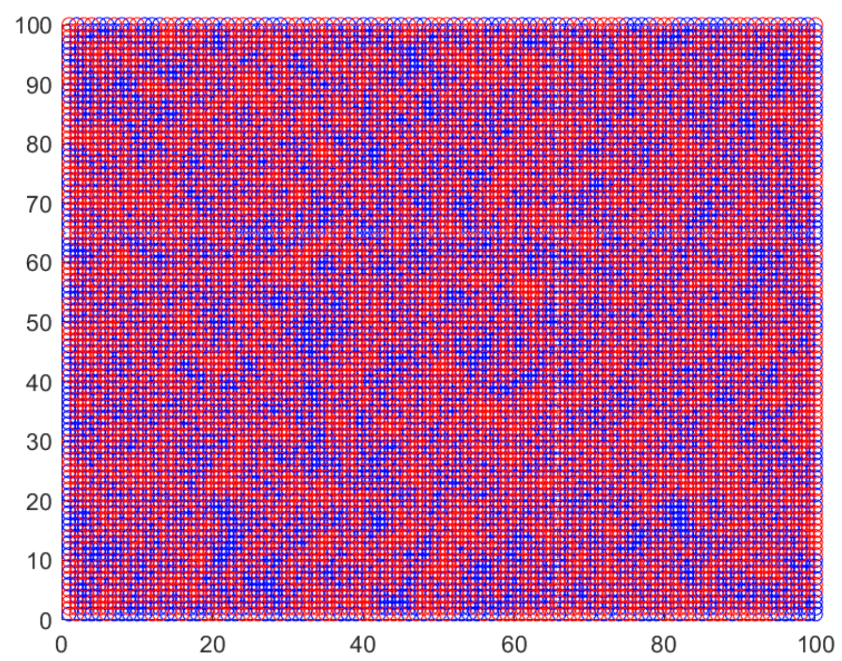
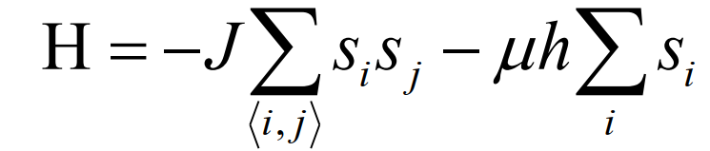
Part 1 – Ising model
The general form of Hamiltonian for the Ising model is
This gives us the energy of the system in some discrete levels, and we can easily find the Boltzmann factor associated with the configuration that has such energy.
In this lab, we are working with nearest-neighbor Ising model, i.e. the only nontrivial interaction happens among the Neumann neighbors.

Slide 4
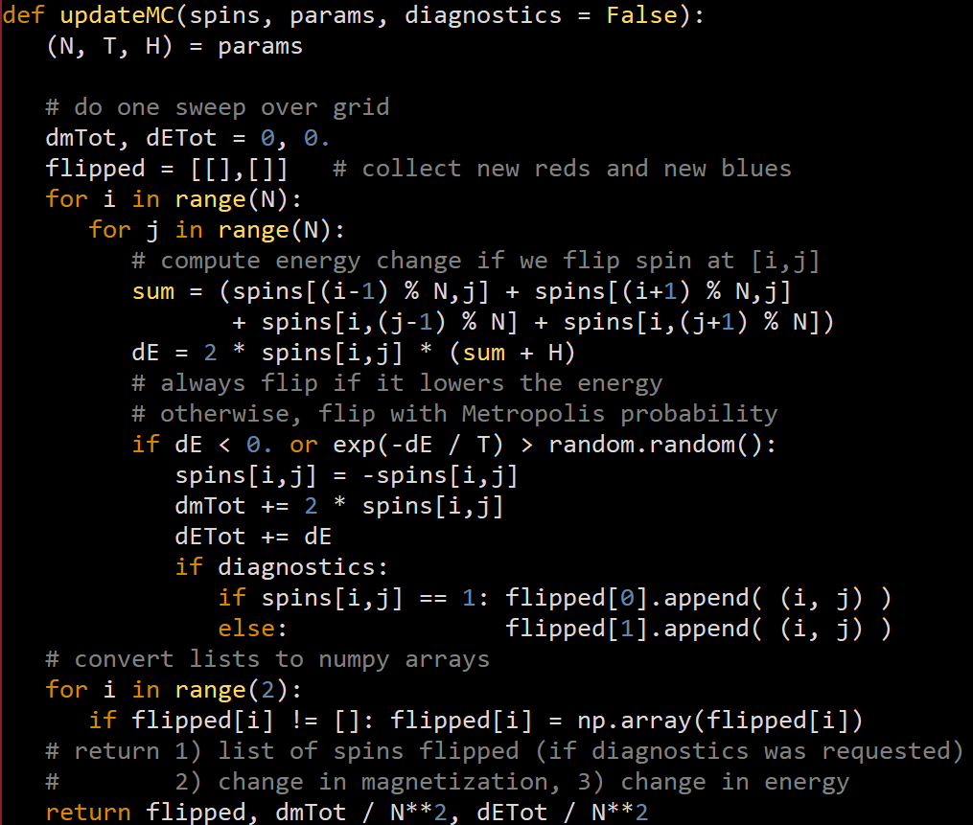
Part 1 – implementation
Compute the sum of interactions. Note that in the index, there is a modulo operator. This means spins[0,a] and spins [N-1,a] are neighbors and spins[b,0] and spins[b,N-1] are neighbors, i.e. our lattice has periodic/cyclic boundary condition. Beware of loaded symbol; H in the code is the external magnetic field, not Hamiltonian.
If the energy change is negative, then it’s energetically favorable to make transition to a new state, i.e. the sign of the current site is flipped. If the transition to flipped state is energetically unfavorable, then the flip will only happen when the Boltzmann factor is bigger than a (pseudo)randomly generated number in the interval [0,1].
1
2

Slide 5
Part I – what to do
Test the default code using small grid (do not submit result from this step on the report).
On a more sizeable lattice, simulate the Ising model for different values of T, and different values of H, at regular intervals. Spread your T values at even intervals around T_c = 2.27 J/k_b, and space your magnetic field strength evenly around H = 0. Make sure to include cases for H = 0 itself.
Observe, and present on the report, how the magnetization (m) and energy (E) per spin converges to equilibrium values, and make qualitative remarks on the equilibrium configuration.

Slide 6
Part II – What to do
Modify the program to demarcate transient time versus steady state, and compute the average and standard error of means for magnetization and energy for the steady state only (i.e. ignore transient period from the calculation).
Plot magnetization and energy as a function of temperature around the critical point, with a very small, positive H to suppress thermal fluctuations. How long your transience is, and how many steps you need to simulate, will depend on what you observed from part 1. See textbook p.266 to see an example of what this looks like for magnetization.

